Slide 1
Introduction for Statistical /Machine Learning
Chih-Sheng (Tommy) Huang
Chih.sheng.huang821@gmail.com

Slide 2
Introduction for Machine Learning
What is machine learning?
Machine learning algorithms build a mathematical model based on sample data, known as "training data", in order to make predictions or decisions without being explicitly programmed to perform the task. [https://en.wikipedia.org/wiki/Machine_learning]
What is the “KEY” in machine learning?
ANS: Data.

Slide 3

Introduction for Machine Learning
“MOST IMPORTANT” is DATA.
“Garbage in, garbage out.”

Slide 4

Introduction for Machine Learning
“MOST IMPORTANT” is DATA.
Data processing is also a science.
Notes:
https://www.ciklum.com/blog/garbage-in-garbage-out-how-to-prepare-your-data-set-for-machine-learning/

Slide 5
Introduction for Machine Learning
Before any projects, please do two right things
Specific Problem: What problem you want to solve?
Right Data (features): What is useful data? More information more better?
Notes:
1. Pre-process your data

Slide 6

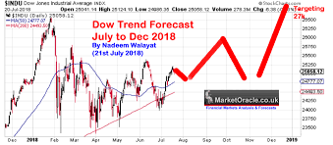


Specific Problem
For instance,
1. Spam email detection
2. Stock Market Forecast
3. Game control
4. Heart attack detection

Slide 7

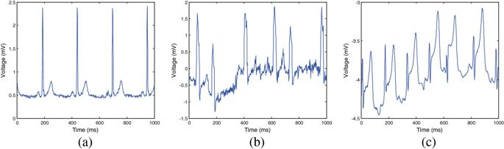
Right Data
For instance,
Spam email detection: mail content
Stock Market Forecast: past price,…
Heart attack detection: ECG signal

Slide 8
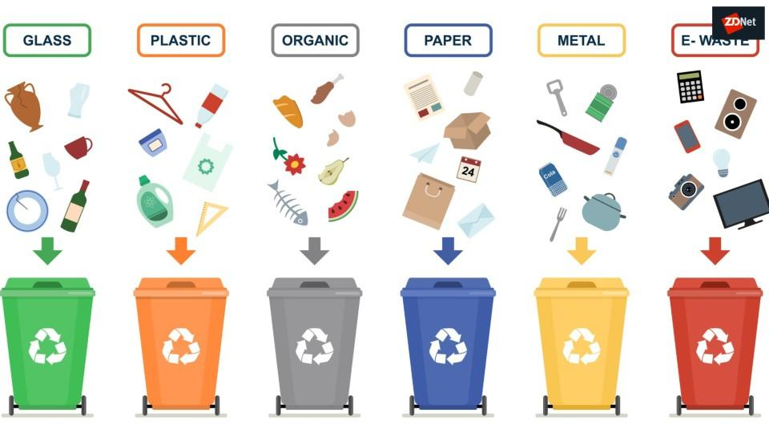
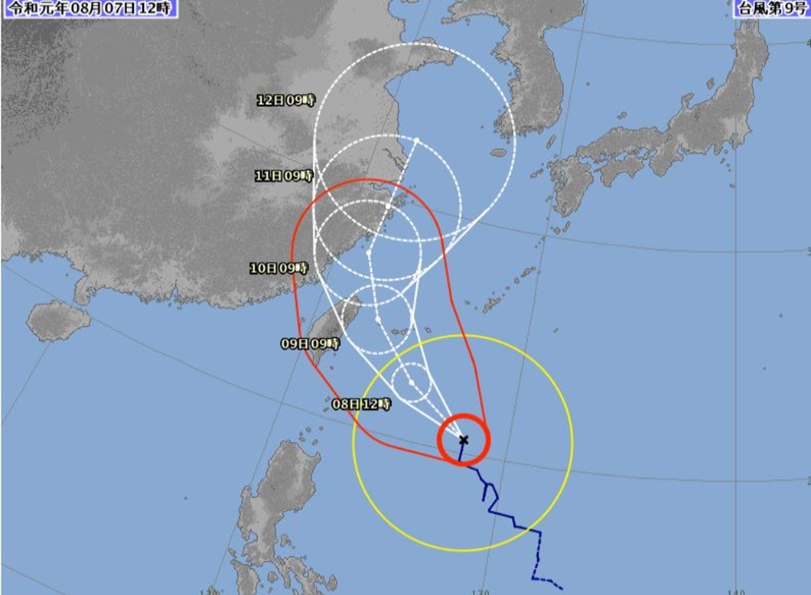
What tasks does ML do?
Depends on what you want it do.
Basically,
Classification
Regression

Slide 9
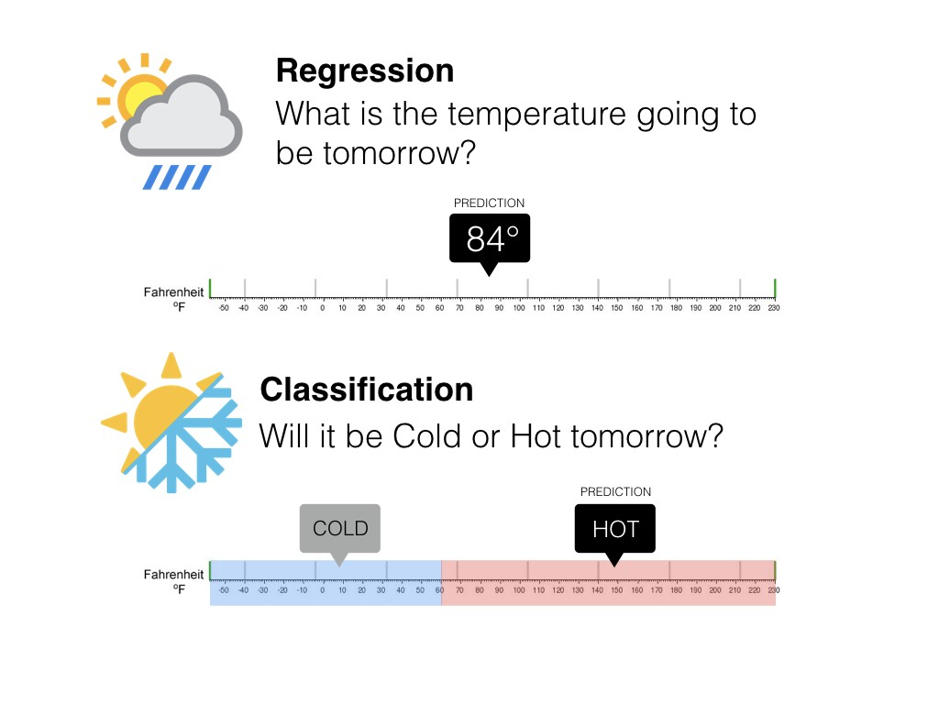
Classification & Regression

Slide 10

Usually classify the machine learning as …
It’s beautiful and almost correct, but NOT really truly classification.
As I know, DAFE (dimension reduction approach) is a supervised learning algorithm.
Notes:
https://towardsdatascience.com/coding-deep-learning-for-beginners-types-of-machine-learning-b9e651e1ed9d

Slide 11
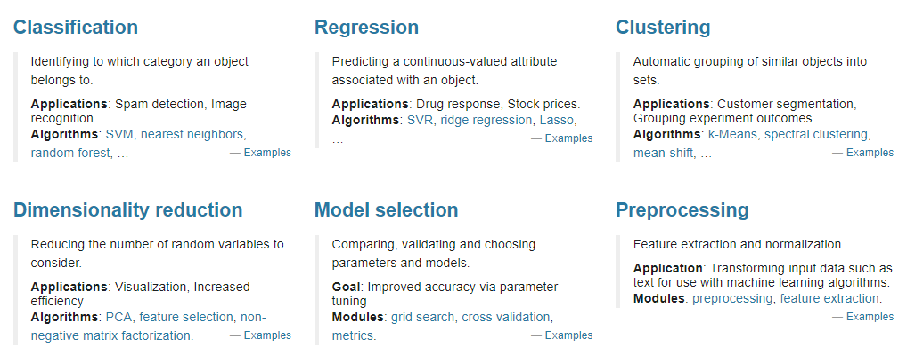

Scikit-learn classification for ML
Notes:
https://scikit-learn.org/stable/index.html

Slide 12
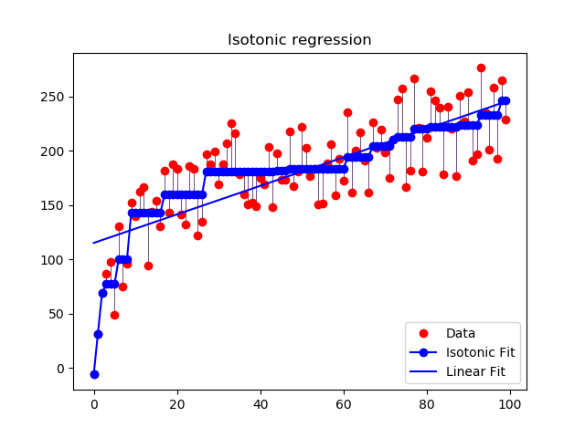
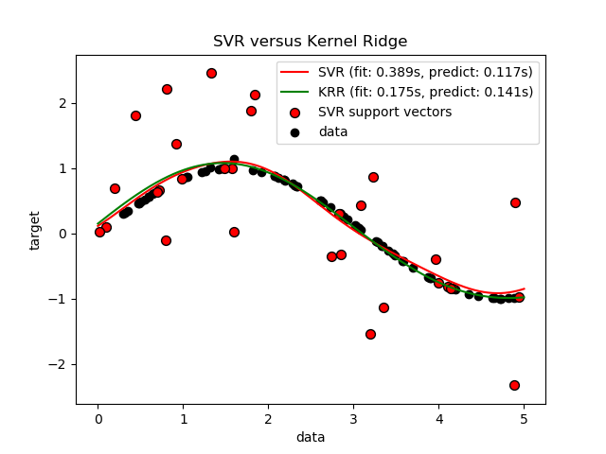
Regression
Predicting a continuous-valued attribute associated with an object.
Linear Regression
Regularized Regression:
Ridge Regression: L2-norm linear regression
LASSO (least absolute shrinkage and selection operator): L1-norm linear regression
Elastic Net: L1+L2-norm linear regression
SVR (support vector regression)
Neural Network

Slide 13
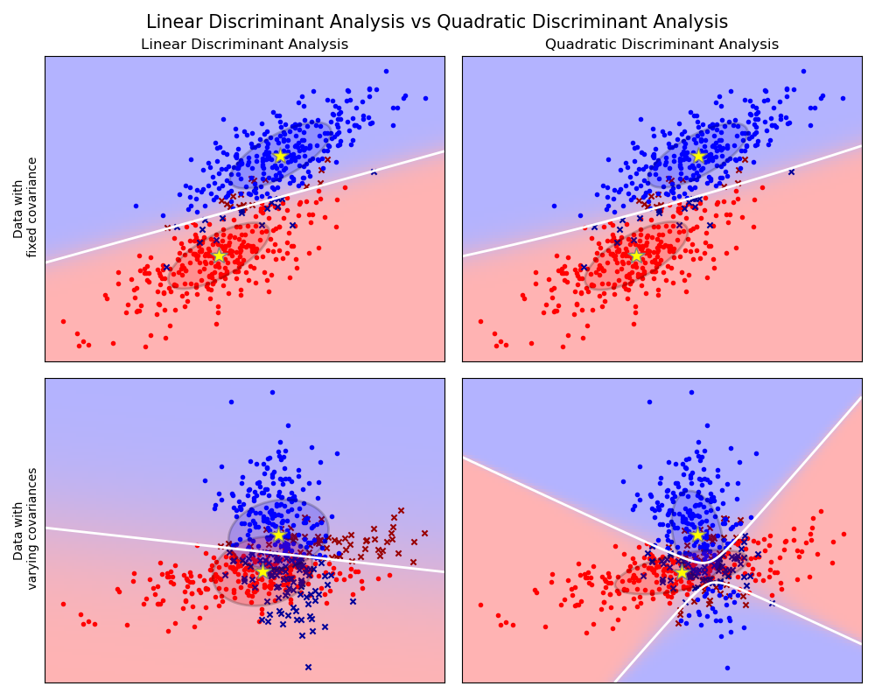
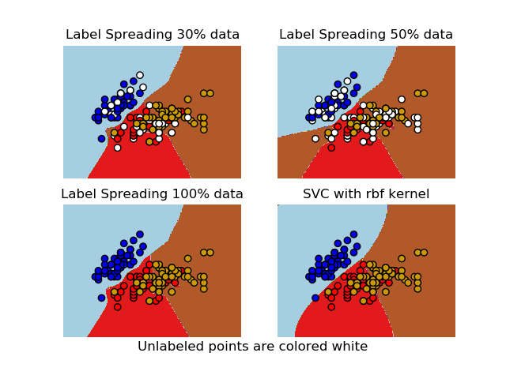
Classification
Identifying to which category an object belongs to.
Logistic Regression
Support Vector Machine
Nearest neighbors
Random forest
Neural Network

Slide 14
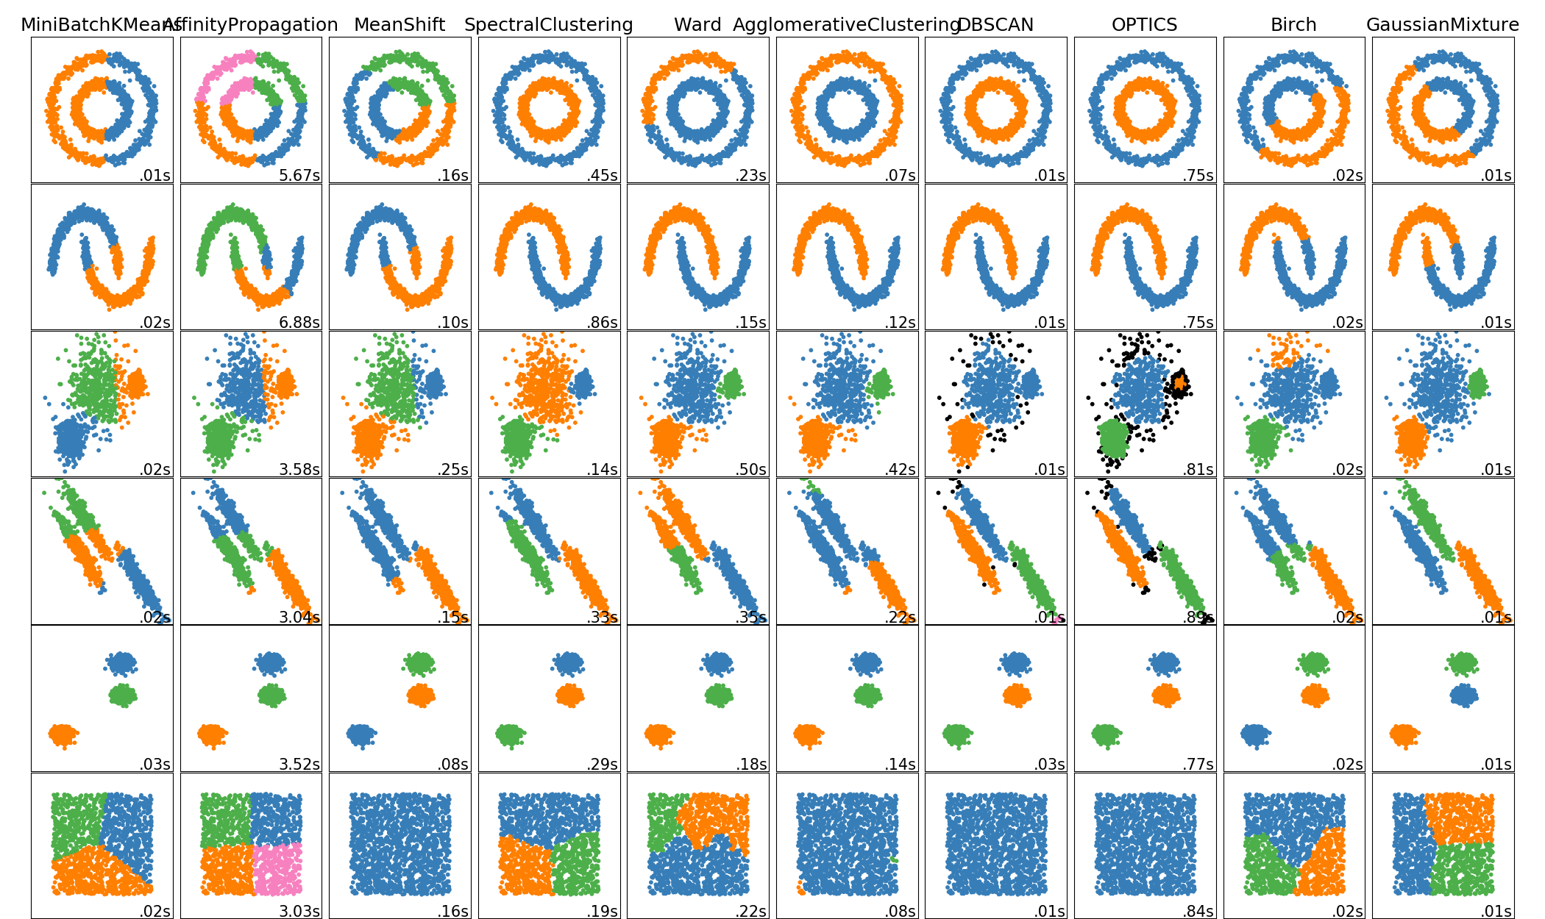
Clustering
Automatic grouping of similar objects into sets.
(物以類聚)
k-Means
spectral clustering
Gaussian mixtures
Neural Network

Slide 15
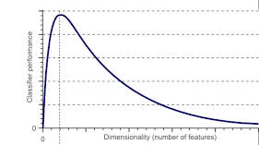
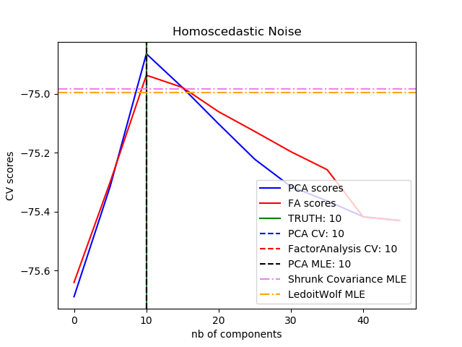
Dimension Reduction
HUGHES PHENOMENON
Reducing the number of random variables to consider.
To overcome curse of dimensionality.
Principal component analysis (PCA)
Independent component analysis (ICA)
Canonical component analysis (CCA)
Non-negative matrix factorization
Discriminant Analysis Feature Extraction(DAFE)
Neural Network

Slide 16

Ensemble learning
Multiclassification System (三個臭皮匠勝過一個諸葛亮)
Ensemble learning
data
Learner 1
Learner 2
Decision
Fusion
Output
…
Learner n

Slide 17
Introduction for these topic
1. Regression
2. Classification (Linear and Quadratic Discriminant Analysis)
3. Dimension Reduction (PCA)
4. Back Propagation Network (BPN)

